Slide 1
MiniMax Mancala w/Alpha Beta Pruning
Michael Wegner, Hamza Zuberi, Carson Meredith
Notes:
Michael

Slide 2
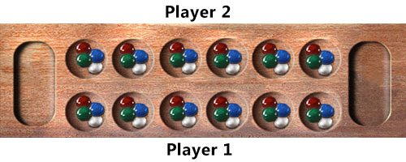
Basics of Mancala
Each player starts with 4 “seeds” in each of their 6 pits, with “stores” at the end of the pits
The player can only move seeds on their side of the board, placing 1 seed in each pit as they move counterclockwise
If the player ends in their store, they get a bonus turn
If the player lands in an empty space on their side, they can “steal” the opposing player’s seeds on the opposite side
The game ends when one player has no seeds in their pits
Or when a player has no chance of winning with remaining moves
The goal is to end the game with the most seeds
Notes:
Michael

Slide 3
Result
In our implementation of a minimax/alpha beta algorithm, we found that using our H1 and H2 heuristics achieved the best performance, and resulted in both forms having nearly identical accuracy, but drastically different run times

Slide 4
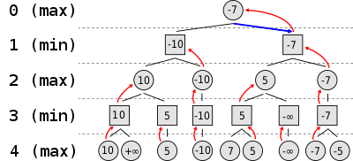
What is MiniMax?
MiniMax is a form of Adversarial search, where one player “MAX” tries to find a sequence of actions it needs to win, while also assuming “MIN”, will make its best move
MiniMax algorithms are typically used when the Agent’s environment is Fully Observable, Multiagent, Deterministic, Sequential, Static and Discrete
Notes:
Hamza

Slide 5
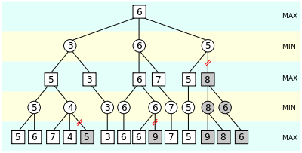
What is Alpha Beta pruning?
Alpha Beta pruning is a way of eliminating nodes of a search tree that are worse than previously evaluated nodes
In the worst case of move ordering Alpha Beta’s runtime is O(b^d)(The same as MiniMax), but O(√b^d) best case
Notes:
Hamza

Slide 6

Why this matters?
A MiniMax mancala algorithm can help a single mancala player learn better game tactics
Playing against an AI such as MiniMax always gives a player someone to play against, and one of good skill at that
This also gives us a simple AI implementation that can be a good template for other AI problems
Notes:
Hamza

Slide 7
Heuristics
H1: Difference between player/opponent
H2: How close player is to winning
H3: How close opponent is to winning
H4: How many seeds are in the player’s pits
Notes:
Carson

Slide 8



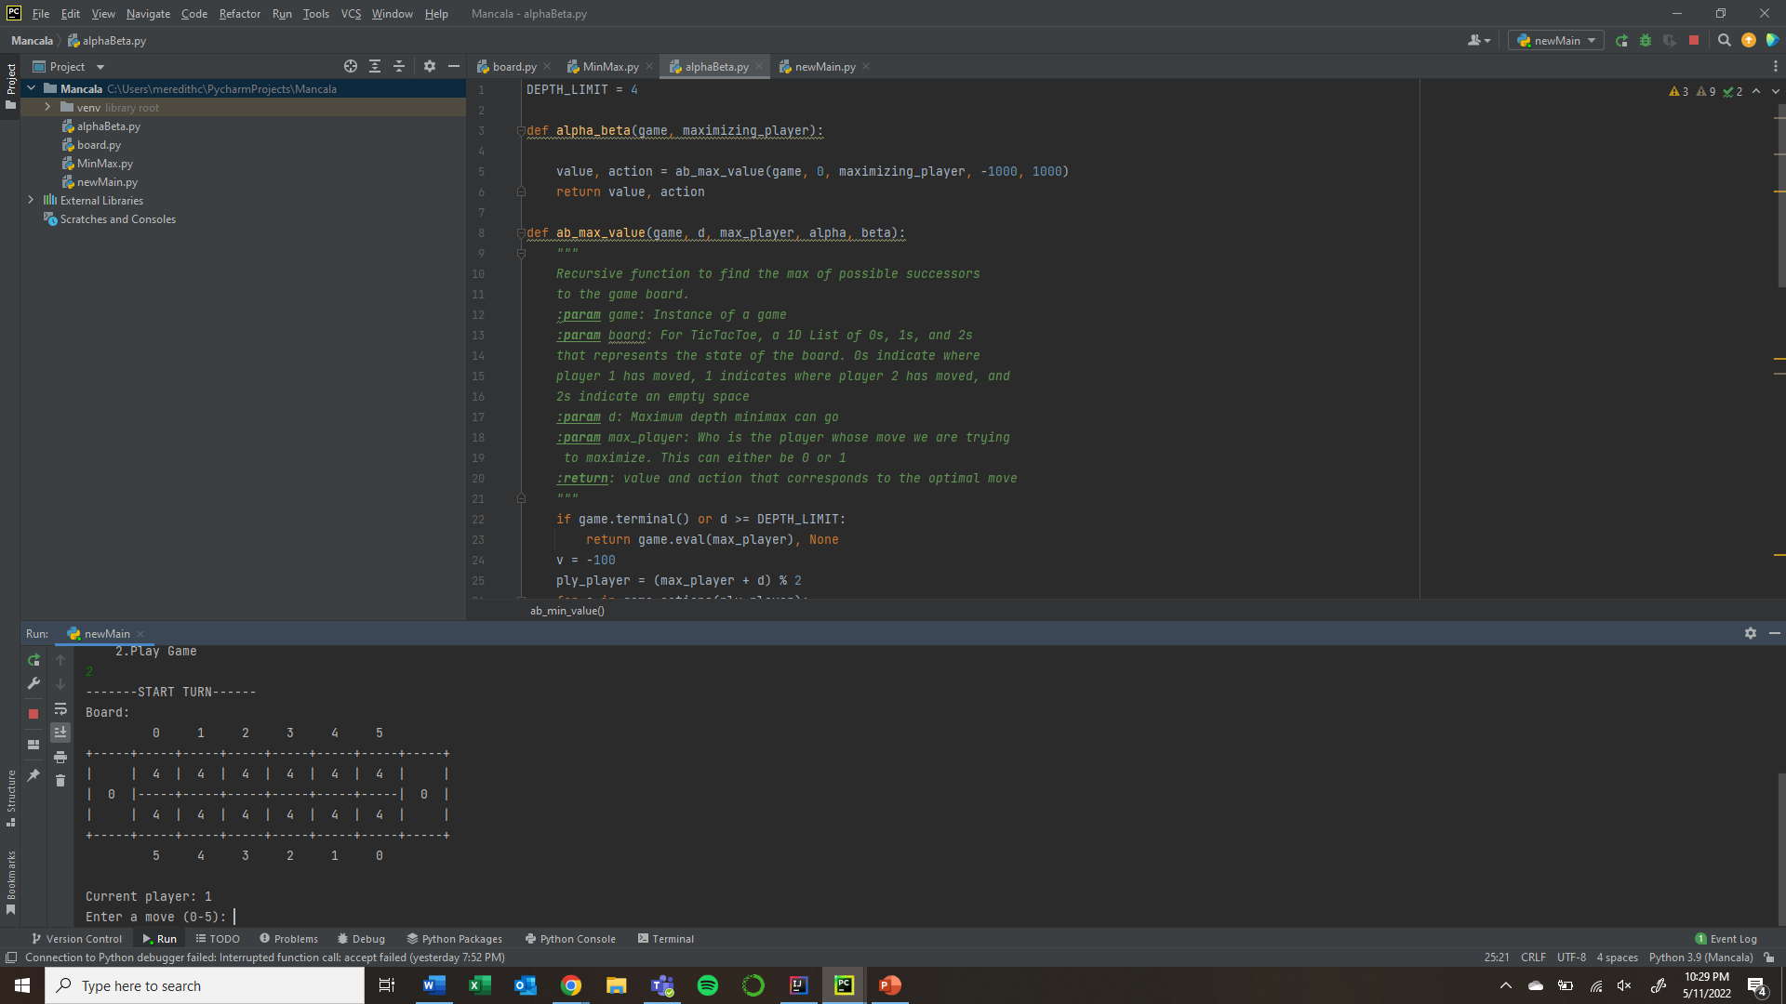


Demonstration
Notes:
Carson

Slide 9
Win Rates
Of all the heuristics used H1 and H2 performed the best
The H1/H2 heuristics were able to achieve 98-100% win rates with depths of 1
The H3 heuristic needs higher depths to even achieve 70-90% win rate
While the H4 heuristic performed worse than random
Notes:
Carson

Slide 10
MiniMax vs Alpha Beta Runtimes
Alpha Beta ran against a random opponent 100 times and took 378 seconds with an average of 3.76 seconds per game with a depth of 6
MiniMax ran against a random opponent 100 times and took 34,463 seconds with an average of 344.63 seconds per game with a depth of 6
Alpha Beta ran against a random opponent 100 times and took 122 seconds with an average of 1.22 seconds per game with a depth of 4
MiniMax ran against a random opponent 100 times and took 229 seconds with an average of 2.29 seconds per game with a depth of 4
Notes:
Carson

Slide 11
MiniMax vs Alpha Beta Memory Usage
Alpha Beta ran against a random opponent 100 times with a depth of 4 and ended with a memory allocation of 26958 blocks and a peak of 32726 blocks
MiniMax ran against a random opponent 100 times with a depth of 4 and ended with a memory allocation of 33750 blocks and a peak of 42030 blocks
Notes:
Carson, a block is 8-512 bytes

Slide 12
MiniMax Pros/Cons
Pros:
Helps perform a thorough assessment of a search space.
Offers decision making in AI, which has further given way to the development of new and smart machines, systems, and computers.
Cons:
Huge branching factor, which can make reaching the goal state slow
Search of unnecessary nodes or branches of the game tree decreases the performance and efficiency
There are lots of possible moves to evaluate in a game
Exploring the entire tree is not probable due to time and space restrictions
Notes:
Michael

Slide 13
Alpha Beta Pros/Cons
Pros:
Elimination of search tree branches
Limits search time to better sub-trees which enables a deeper search
Reduces computation and searching through the tree
Prevents additional computational time, making the process quicker
Cons:
Requires a depth limit, most of the time it is not feasible to search the entire tree
Designed to calculate the best move, it also calculates the values of all the legal moves
Notes:
Michael

Slide 14
References
https://en.wikipedia.org/wiki/Minimax
https://en.wikipedia.org/wiki/Alpha%E2%80%93beta_pruning
https://digitalcommons.andrews.edu/cgi/viewcontent.cgi?article=1259&context=honors
https://fiasco.ittc.ku.edu/publications/documents/Gifford_ITTC-FY2009-TR-03050-03.pdf

